Slide 1

Data Wrangling

Slide 2
Objectives
Data Wrangling Overview
Introduce dataset columns
Data Wrangling

Slide 3
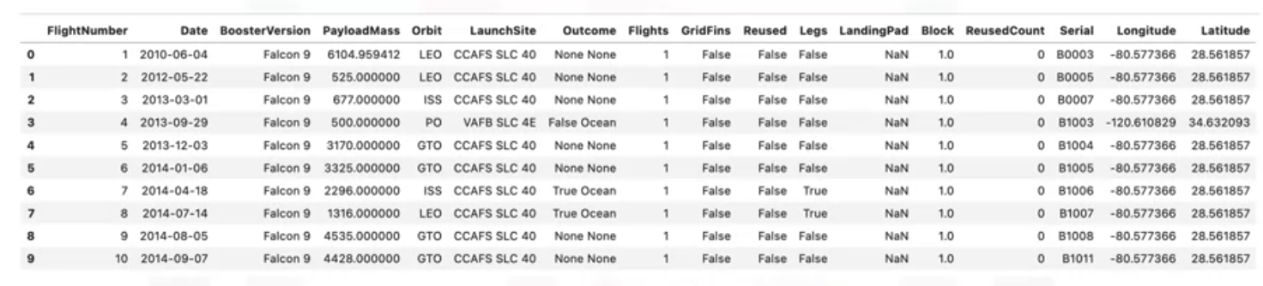
Data Wrangling Overview
Overview of dataset:
Data Wrangling
Notes:
Outcome: this is the status of the first stage
Flights,
Grid Fins: these help with landing
Reused,
Legs: used in landing
Landing pad,
Block,
Reused count,
Serial,
Longitude and latitude of launch

Slide 4
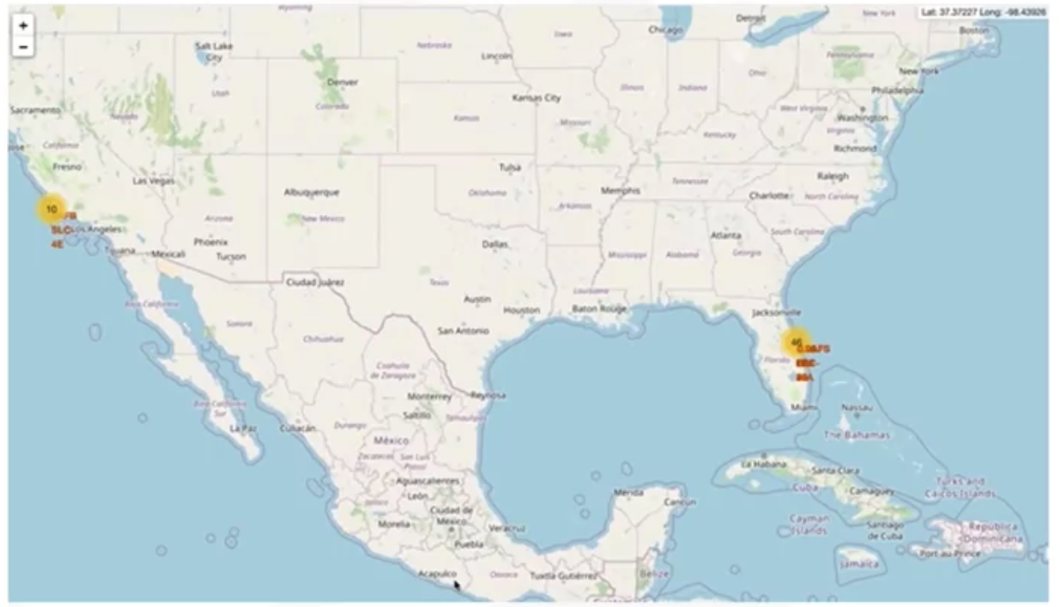
Data Wrangling Overview
The column “LaunchSite” contains the different launch sites, including: Vandenberg AFB Space Launch, Kennedy Space Center, CCAFS SLC 40
Data Wrangling
Notes:
Outcome: this is the status of the first stage
Flights,
Grid Fins: these help with landing
Reused,
Legs: used in landing
Landing pad,
Block,
Reused count,
Serial,
Longitude and latitude of launch

Slide 5
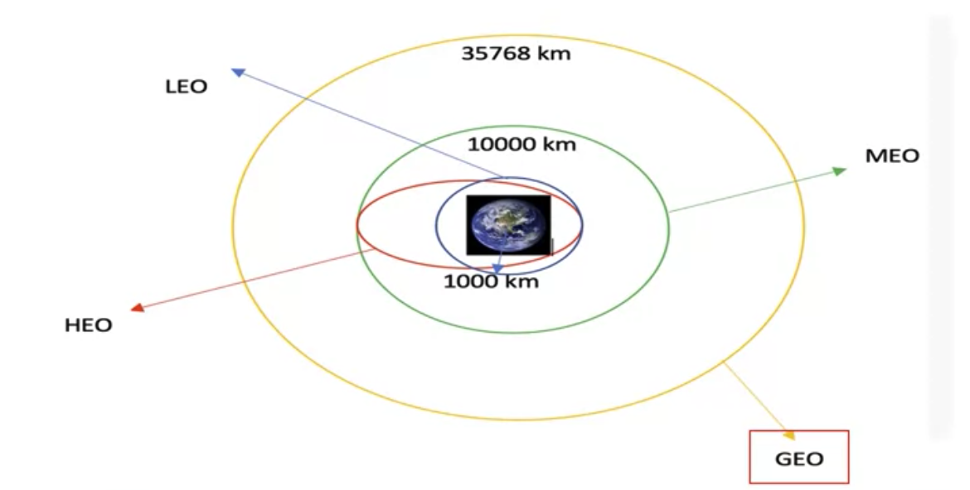
Data Wrangling Overview
The column orbits are the different orbits of the payload.
Data Wrangling
Notes:
The column orbits are the different orbits of the payload. For Example: LEO: Low Earth orbit (LEO)is an Earth-centered orbit with an altitude of 2,000 km GTO A geosynchronous orbit is a high Earth orbit that allows satellites to match Earth's rotation. It is located at 22,236 miles (35,786 kilometers) above Earth's equator.

Slide 6
Data Wrangling Overview
The column orbits are the different orbits of the payload
  LEO: Low Earth orbit (LEO)is an Earth-centred orbit with an altitude of 2,000 km (1,200 mi) or less (approximately one-third of the radius of Earth) or with at least 11.25 periods per day (an orbital period of 128 minutes or less) and an eccentricity less than 0.25. Most of the manmade objects in outer space are in LEO.
  PO: It is one type of satellite in which a satellite passes above or nearly above both poles of the body being orbited (usually a planet such as the Earth
Data Wrangling
Notes:
The column orbits are the different orbits of the payload. For Example: LEO: Low Earth orbit (LEO)is an Earth-centered orbit with an altitude of 2,000 km GTO A geosynchronous orbit is a high Earth orbit that allows satellites to match Earth's rotation. It is located at 22,236 miles (35,786 kilometers) above Earth's equator.

Slide 7
Data Wrangling Overview
The column orbits are the different orbits of the payload
  VLEO: Very Low Earth Orbits (VLEO) can be defined as orbits with a mean altitude below 450 km. Operating in these orbits can provide a number of benefits to Earth observation spacecraft as the spacecraft operates closer to the observation.
  GEO: It is a circular geosynchronous orbit 35,786 kilometers (22,236 miles) above Earth's equator and following the direction of Earth's rotation
Data Wrangling
Notes:
The column orbits are the different orbits of the payload. For Example: LEO: Low Earth orbit (LEO)is an Earth-centered orbit with an altitude of 2,000 km GTO A geosynchronous orbit is a high Earth orbit that allows satellites to match Earth's rotation. It is located at 22,236 miles (35,786 kilometers) above Earth's equator.

Slide 8
Data Wrangling Overview
The column orbits are the different orbits of the payload
  GTO: A geosynchronous orbit is a high Earth orbit that allows satellites to match Earth's rotation. Located at 22,236 miles (35,786 kilometers) above Earth's equator, this position is a valuable spot for monitoring weather, communications, and surveillance. Because the satellite orbits at the same speed that the Earth is turning, the satellite seems to stay in place over a single longitude, though it may drift north to south,” NASA wrote on its Earth Observatory website.
Data Wrangling
Notes:
The column orbits are the different orbits of the payload. For Example: LEO: Low Earth orbit (LEO)is an Earth-centered orbit with an altitude of 2,000 km GTO A geosynchronous orbit is a high Earth orbit that allows satellites to match Earth's rotation. It is located at 22,236 miles (35,786 kilometers) above Earth's equator.

Slide 9
Data Wrangling Overview
The column orbits are the different orbits of the payload
  SSO (or SO): It is a Sun-synchronous orbit also called a heliosynchronous orbit is a nearly polar orbit around a planet, in which the satellite passes over any given point of the planet's surface at the same local mean solar time.
  HEO: Geocentric orbits above the altitude of the geosynchronous orbit (35,786 km or 22,236 mi).
Data Wrangling
Notes:
The column orbits are the different orbits of the payload. For Example: LEO: Low Earth orbit (LEO)is an Earth-centered orbit with an altitude of 2,000 km GTO A geosynchronous orbit is a high Earth orbit that allows satellites to match Earth's rotation. It is located at 22,236 miles (35,786 kilometers) above Earth's equator.

Slide 10
Data Wrangling Overview
The column orbits are the different orbits of the payload
  ES-L1 : At the Lagrange points the gravitational forces of the two large bodies cancel out in such a way that a small object placed in orbit there is in equilibrium relative to the center of mass of the large bodies. L1 is one such point between the sun and the earth.
  HEO A highly elliptical orbit, is an elliptic orbit with high eccentricity, usually referring to one around Earth.
Data Wrangling
Notes:
The column orbits are the different orbits of the payload. For Example: LEO: Low Earth orbit (LEO)is an Earth-centered orbit with an altitude of 2,000 km GTO A geosynchronous orbit is a high Earth orbit that allows satellites to match Earth's rotation. It is located at 22,236 miles (35,786 kilometers) above Earth's equator.

Slide 11
Data Wrangling Overview
The column orbits are the different orbits of the payload
  ISS: A modular space station (habitable artificial satellite) in low Earth orbit. It is a multinational collaborative project between five participating space agencies: NASA (United States), Roscosmos (Russia), JAXA (Japan), ESA (Europe), and CSA (Canada).
  MEO: Geocentric orbits range in altitude from 2,000 km (1,200 mi) to just below geosynchronous orbit at 35,786 kilometers (22,236 mi). Also known as an intermediate circular orbit. These are "most commonly at 20,200 kilometers (12,600 mi), or 20,650 kilometers (12,830 mi), with an orbital period of 12 hours.
Data Wrangling
Notes:
The column orbits are the different orbits of the payload. For Example: LEO: Low Earth orbit (LEO)is an Earth-centered orbit with an altitude of 2,000 km GTO A geosynchronous orbit is a high Earth orbit that allows satellites to match Earth's rotation. It is located at 22,236 miles (35,786 kilometers) above Earth's equator.

Slide 12
Data Wrangling Overview
The column Outcome indicates if the first stage successfully landed.
There are 8 status:
  True Ocean
  None ASDS
  False Ocean
  False RTLS
  True ASDS ← successfully landed to a drone ship
  None None
  True RTLS
  False ASDS← mission outcome was unsuccessfully landed to a drone ship
Data Wrangling

Slide 13
Data Wrangling Overview
Outcome column to be converted to Classes y (either 0 or 1)
0 is a bad outcome: the booster did not land
1 is a good outcome: the booter did land
Data Wrangling

Slide 14
Summary
Data Wrangling Overview
Introduce dataset columns
Data Wrangling

Slide 15
Q & A
Data Wrangling

